Slide 1

LPUMUSIC
CSE326
PROJECT REPORT

Slide 2

REPORT FOR LPU MUSIC
Name : Vikash
Registration Number : 12317439
Section : k23GU
Roll Number : 09
Program : CSE B.Tech
Semester : FIRST
School : School of Computer Science
Name of the University : Lovely Professional University
Submitted To : Sheetal Chahaun

Slide 3

ABSTRACT:-
A music website is basically a webpage where one can play/pause music. It has other options like the home section, music section, about section, contact section, etc. In this project, we are going to make a website that will play/pause music using HTML, CSS, and JavaScript. We will use HTML to give a basic layout and with CSS, we will give beautify our design by giving aground and play pause button image. We will use basic JavaScript feature like if-else and document.getElementById to play and pause our music.

Slide 4
ACKNOWLEDGEMENT:-
We would like to express our heartfelt gratitude to ms. Sheetal Chahaun
for giving us the opportunity to work under her guidance and help us gain immensely enriching professional experience. Our sincere thanks to project in charge and our internal project guide for giving us valuable inputs and ideas right from the selection of topic for project until its successful completion.
Many thanks to my friends and senior’s as well, who spent countless hours to listen and provide feedbacks.

Slide 5
ABSTRACT | 2
INTRODUCTION | 4
OBJECTIVE | 6
PURPOSE | 7
SCREEN DESIGN | 8
CODE | 13
CONCLUSION | 39
REFRENCES | 40
TABLE OF CONTENT PAGE

Slide 6
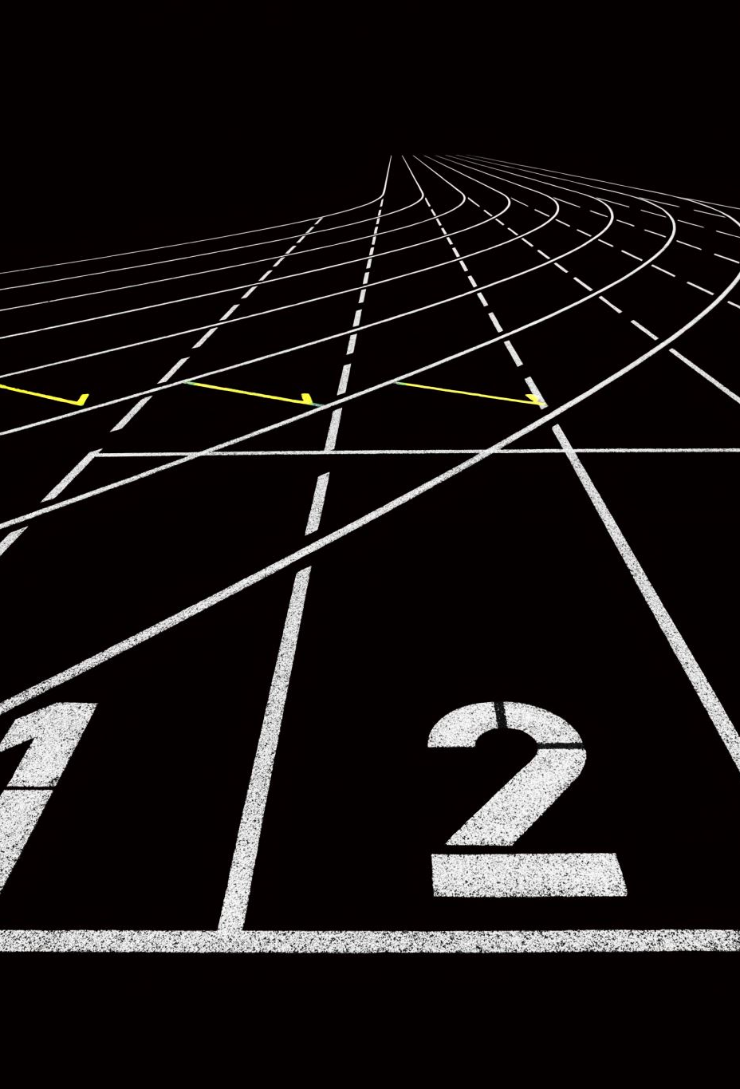
Approach:
We will create the basic layout i.e. divs (left and right) inside one div tag. In the left div we will write some text and in the right div we will place play or pause image. We will also create a basic nav-bar and float in the right.
With the help of CSS, we will beautify our overall structure by giving background image, padding, margin etc.
We will use basic JavaScript functions like onclick(), play() , pause() and getElementById() to get the current status of music and make changes accordingly.
When user will play the music we will show play image or icon and when user presses pause pause image or icon will be displayed. This is done using simple if-else statement.

Slide 7
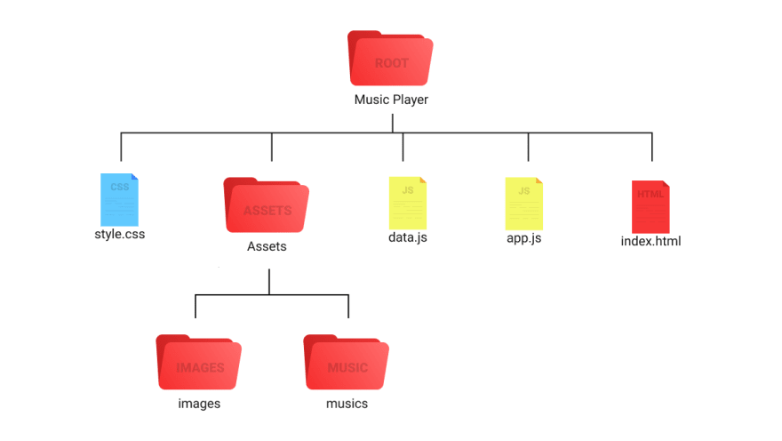
Code
Before we start writing our code. Although it's not a Nodejs app but we should see its folder structure at least.

Slide 8

INTRODUCTION
This study is based on finding out ways to facilitating easy access of preferred songs by customers, according to the various brtistes, genre, year of recording of their choice on the internet without much stress. Moreover, there are plenty of songs out of there, which different people want to be able to either stream online, buy albums, check for upcoming songs and album and able to download certain songs for free as well. This inevitably creates a solution for both the customers get their required songs with ease and artistes get paid for their songs when customers buy, stream or download their songs online.

Slide 9
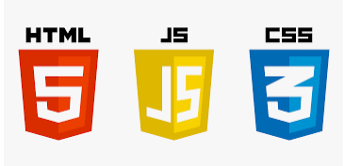
Concepts Used:
In the making of this project, we have used the concepts that have been thought to us in class and we have used those conceptual learnings to improvise it.
The concepts used are:
1) HTML 5
2) CSS
3) External CSS
4) Internal CSS
5) JavaScript

Slide 10

1) HTML 5:
HTML5 is a markup language used for structuring and presenting content on the World Wide Web. It is the fifth and final major HTML version that is a World Wide Web Consortium (W3C) recommendation. The current specification is known as the HTML Living Standard. It is maintained by the Web Hypertext Application Technology Working Group (WHATWG), a consortium of the major browser vendors (Apple, Google, Mozilla, and Microsoft).

Slide 11
2) Cascading Style Sheets:
Cascading Style Sheets (CSS) is a style sheet language used for describing the presentation of a document written in a markup language such as HTML or XML (including XML dialects such as SVG, MathML, or XHTML). CSS is a cornerstone technology of the World Wide Web, alongside HTML and JavaScript.^{[2]}
CSS is designed to enable the separation of content and presentation, including layout, colors, and fonts. This separation can improve content accessibility; provide more flexibility and control in the specification of presentation characteristics; enable multiple web pages to share formatting by specifying the relevant CSS in a separate .css file, which reduces complexity and repetition in the structural content; and enable the .css file to be cached to improve the page load speed between the pages that share the file and its formatting.

Slide 12

3) External CSS:
With an external style sheet, you can change the look of an entire website by changing just one file! Each HTML page must include a reference to the external style sheet file inside the <link> element, inside the head section. An external style sheet can be written in any text editor and must be saved with a .css extension. The external .css file should not contain any HTML tags.

Slide 13

4) Internal CSS:
Internal CSS is used to define a style for a single HTML page. An internal CSS is defined in the <head> section of an HTML page, within an <style> element. The following example sets the text color of ALL the <h1> elements (on that page) to blue and the text color of ALL the <p> elements to red. In addition, the page will be displayed with a "powder blue" background color:

Slide 14
5) JavaScript:
JavaScript often abbreviated as JS, is a programming language that is one of the core technologies of the World Wide Web, alongside HTML and CSS. As of 2022, 98% of websites use JavaScript on the client side for webpage behavior, often incorporating third-party libraries. All major web browsers have a dedicated JavaScript engine to execute the code on users' devices.
JavaScript is a high-level, often just-in-time compiled language that conforms to the ECMAScript standard. It has dynamic typing, prototype-based object orientation, and first-class functions. It is a multi-paradigm, supporting event-driven, functional, and imperative programming styles. It has application programming interfaces (APIs) for working with text, dates, regular expressions, standard data structures, and the Document Object Model (DOM).

Slide 15

We have made sections on our site:
1) Main Page(html)
2) CSS(style.css)
3) Sign Up and Login Page(

Slide 16
Tags, Attributes, Conditions and Loops Used:
In this project we have used variety of tags, attributes, conditions and loops.
Some major tags are:
<script>
<link>
<style>
<div>
<ul>
<hedder>
<fotter>
<a>
<img>
10)<center> , etc
In CSS we have used selectors such as:
Id (#)
Class(.)
Element (with element_name)
Universal (*)
In JavaScript we have used:
getElementById()
<script>
document.write(), etc

Slide 17
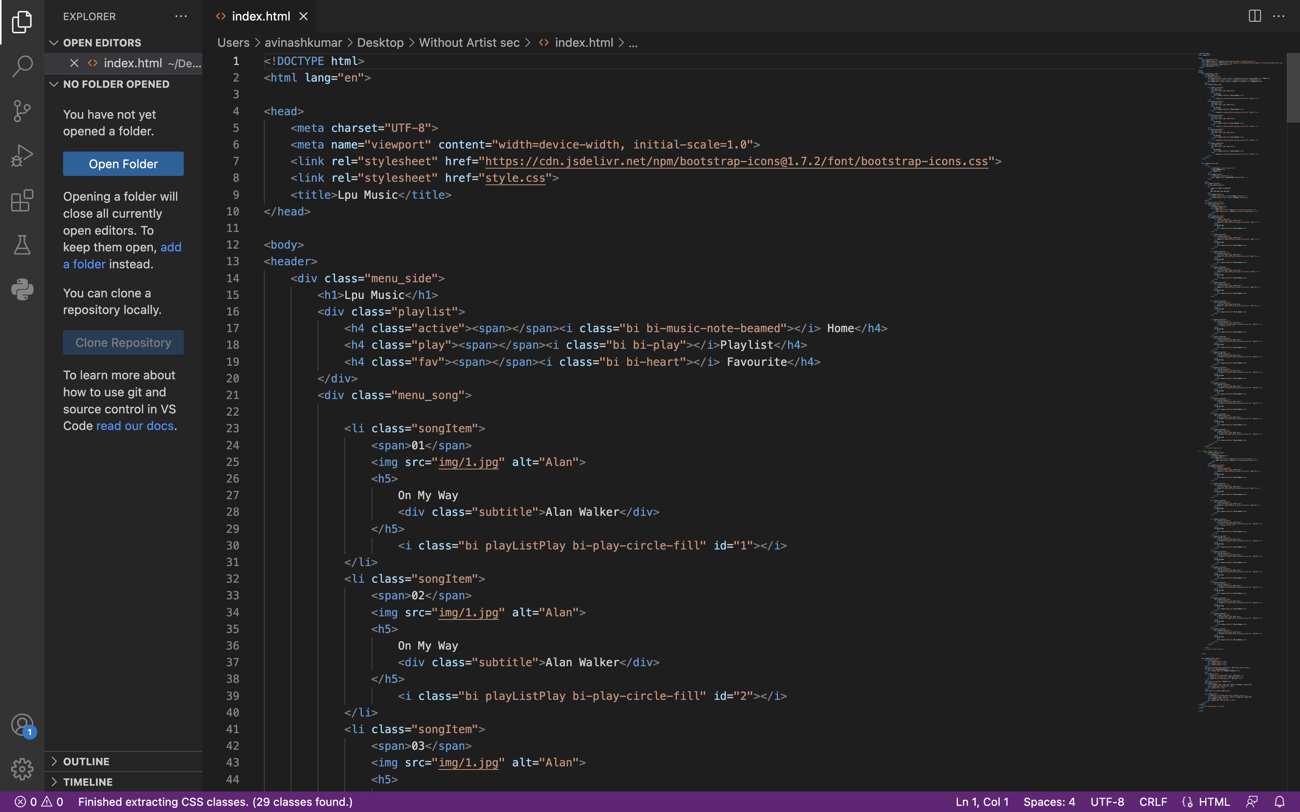
These are the images of the code: HTML

Slide 18
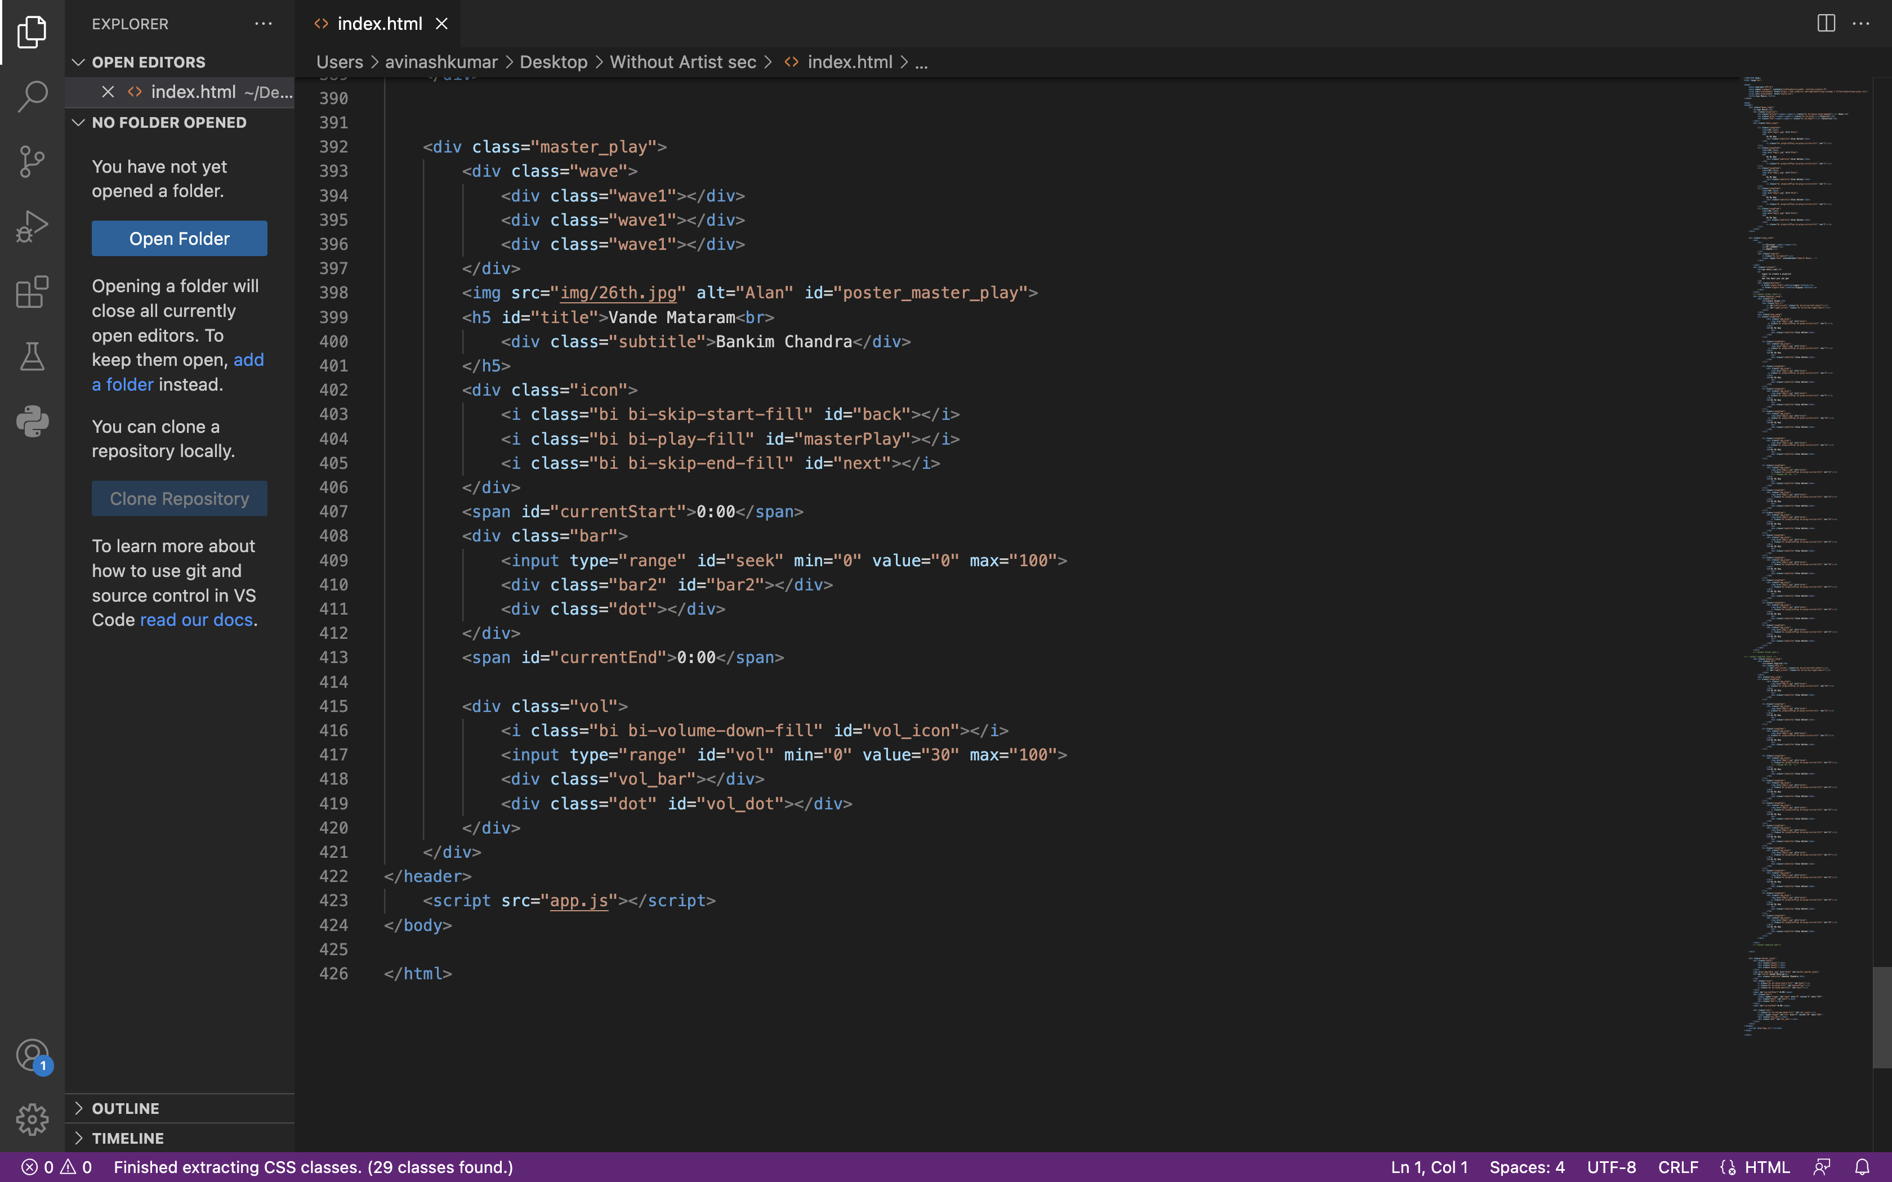
Html For Master Player:-

Slide 19
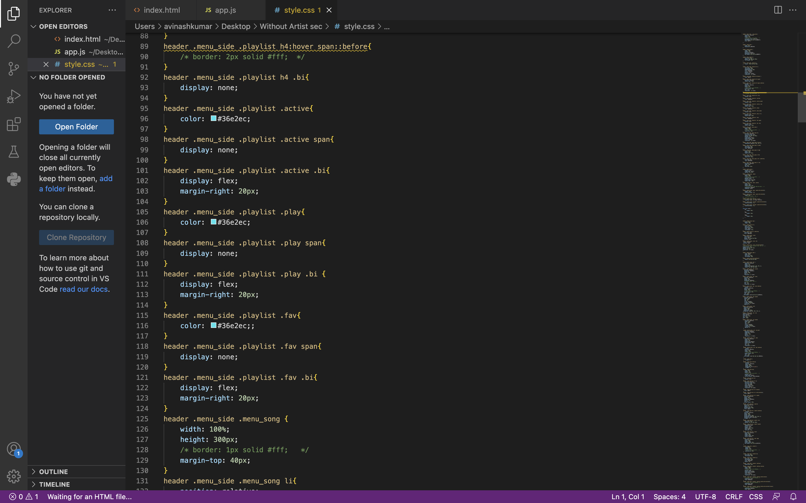
Cascading Style Sheets

Slide 20
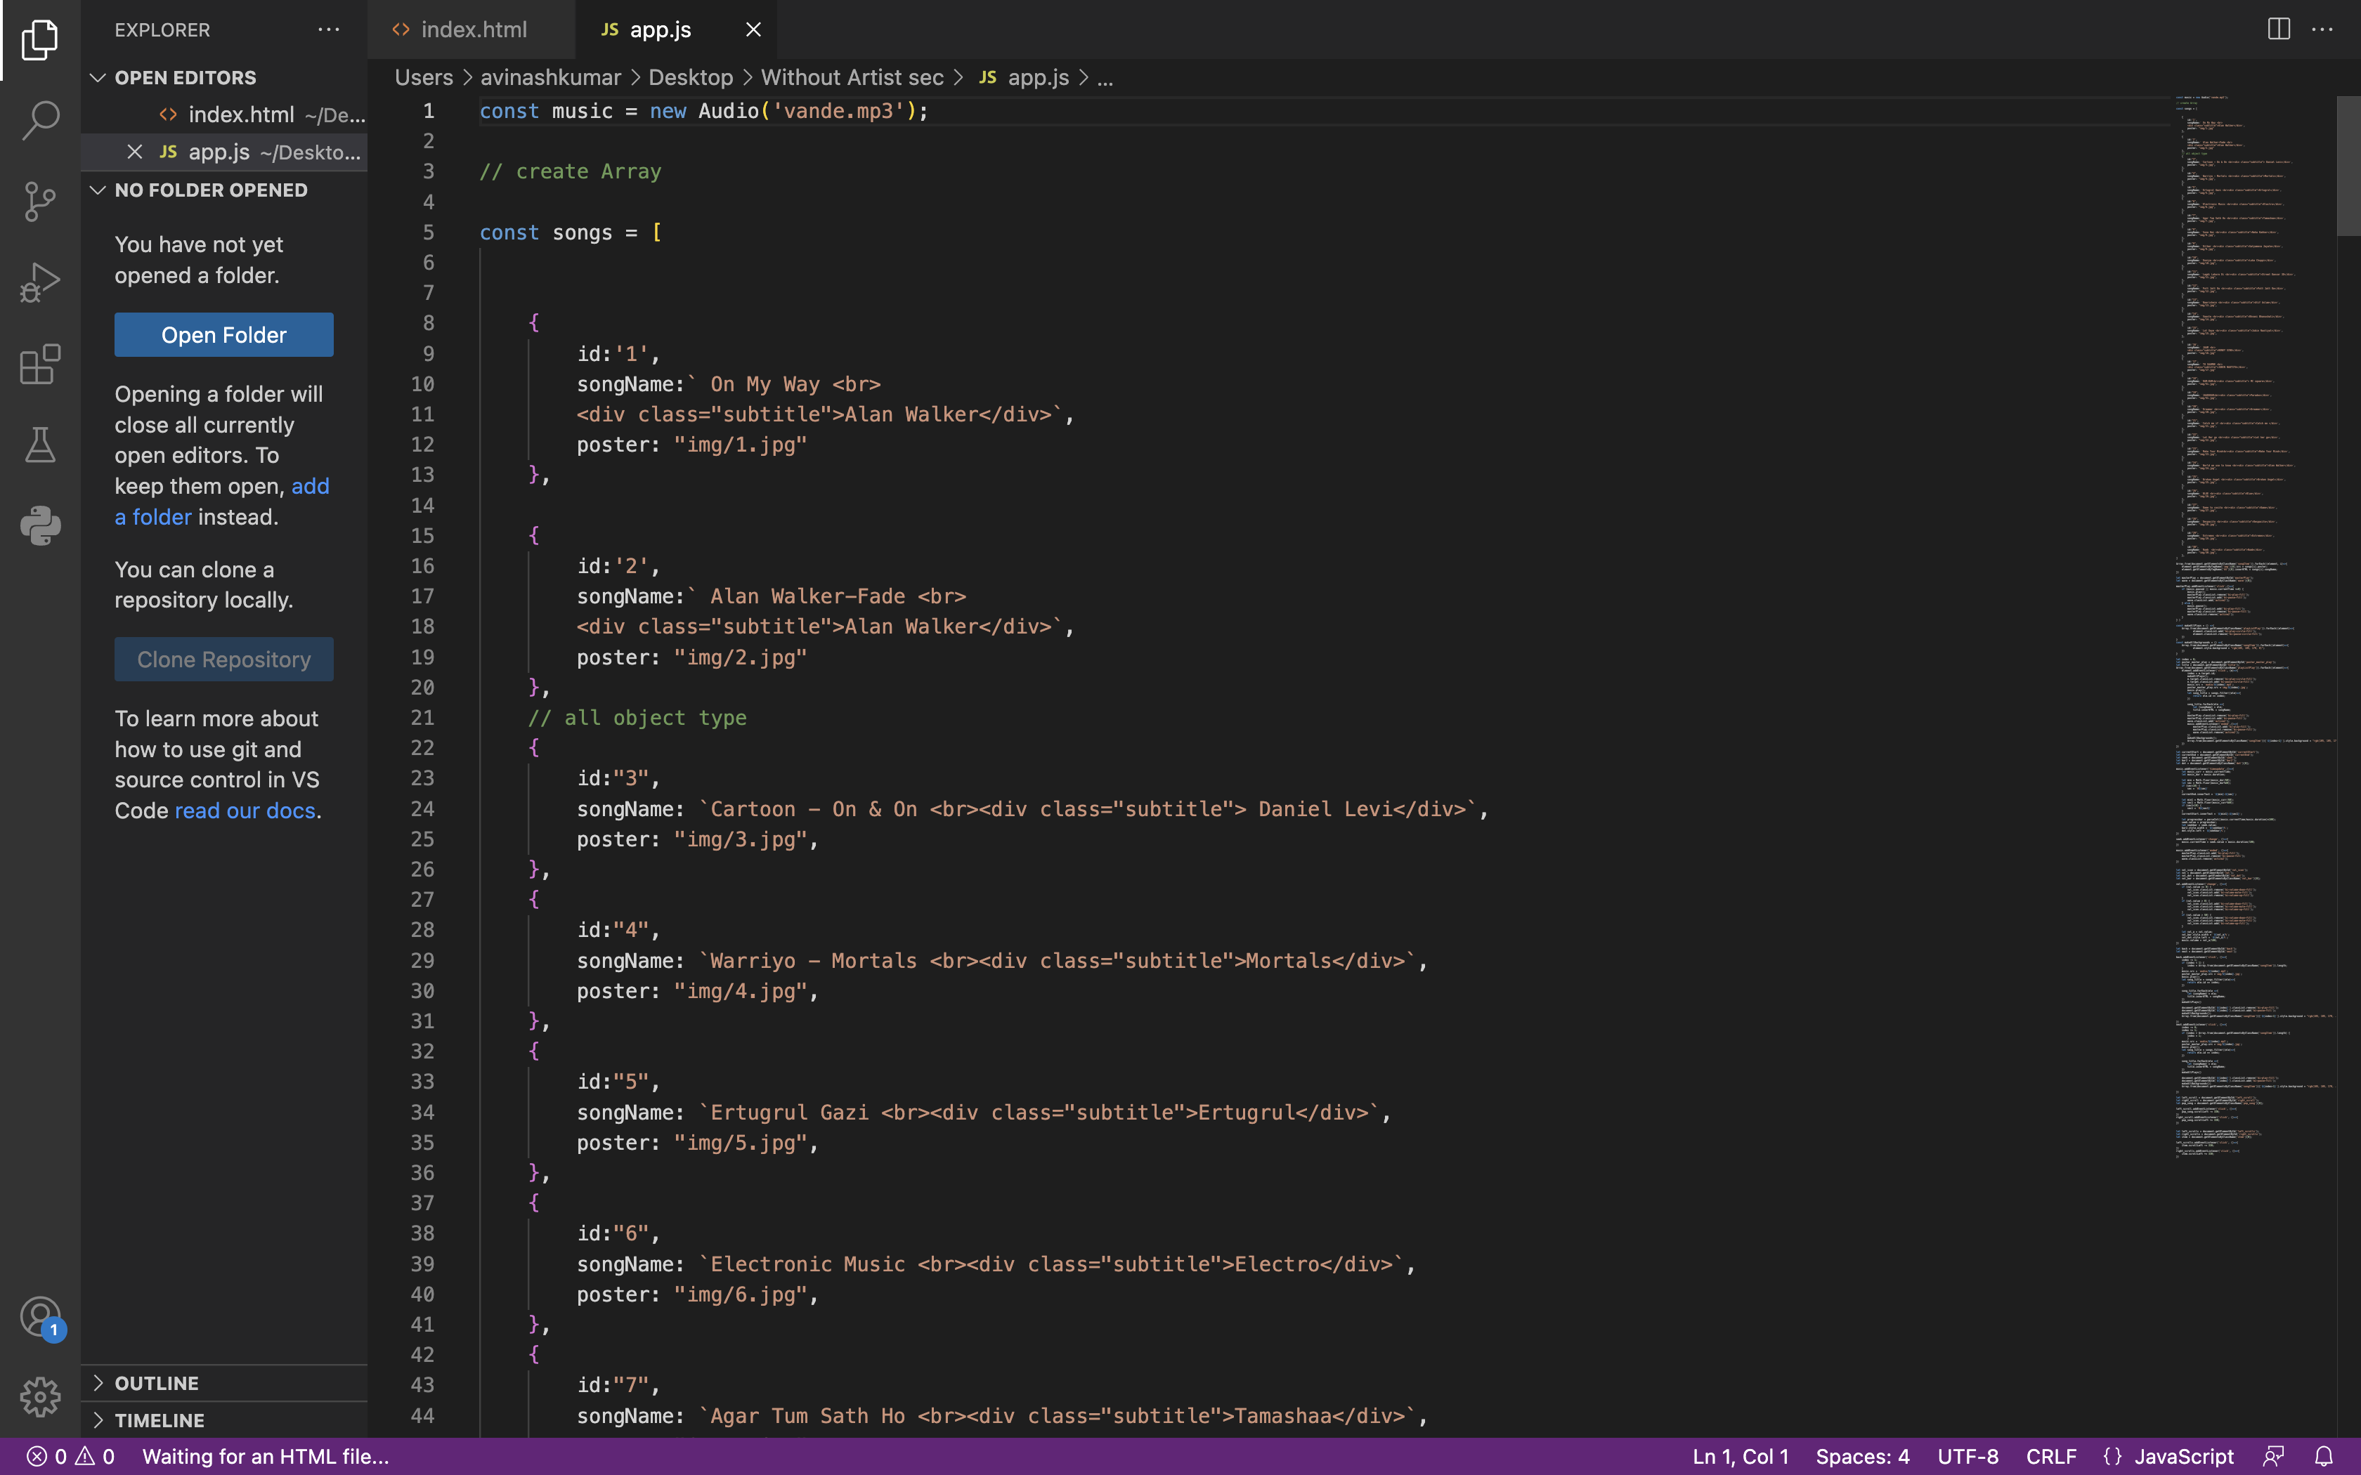
JavaScript:-

Slide 21
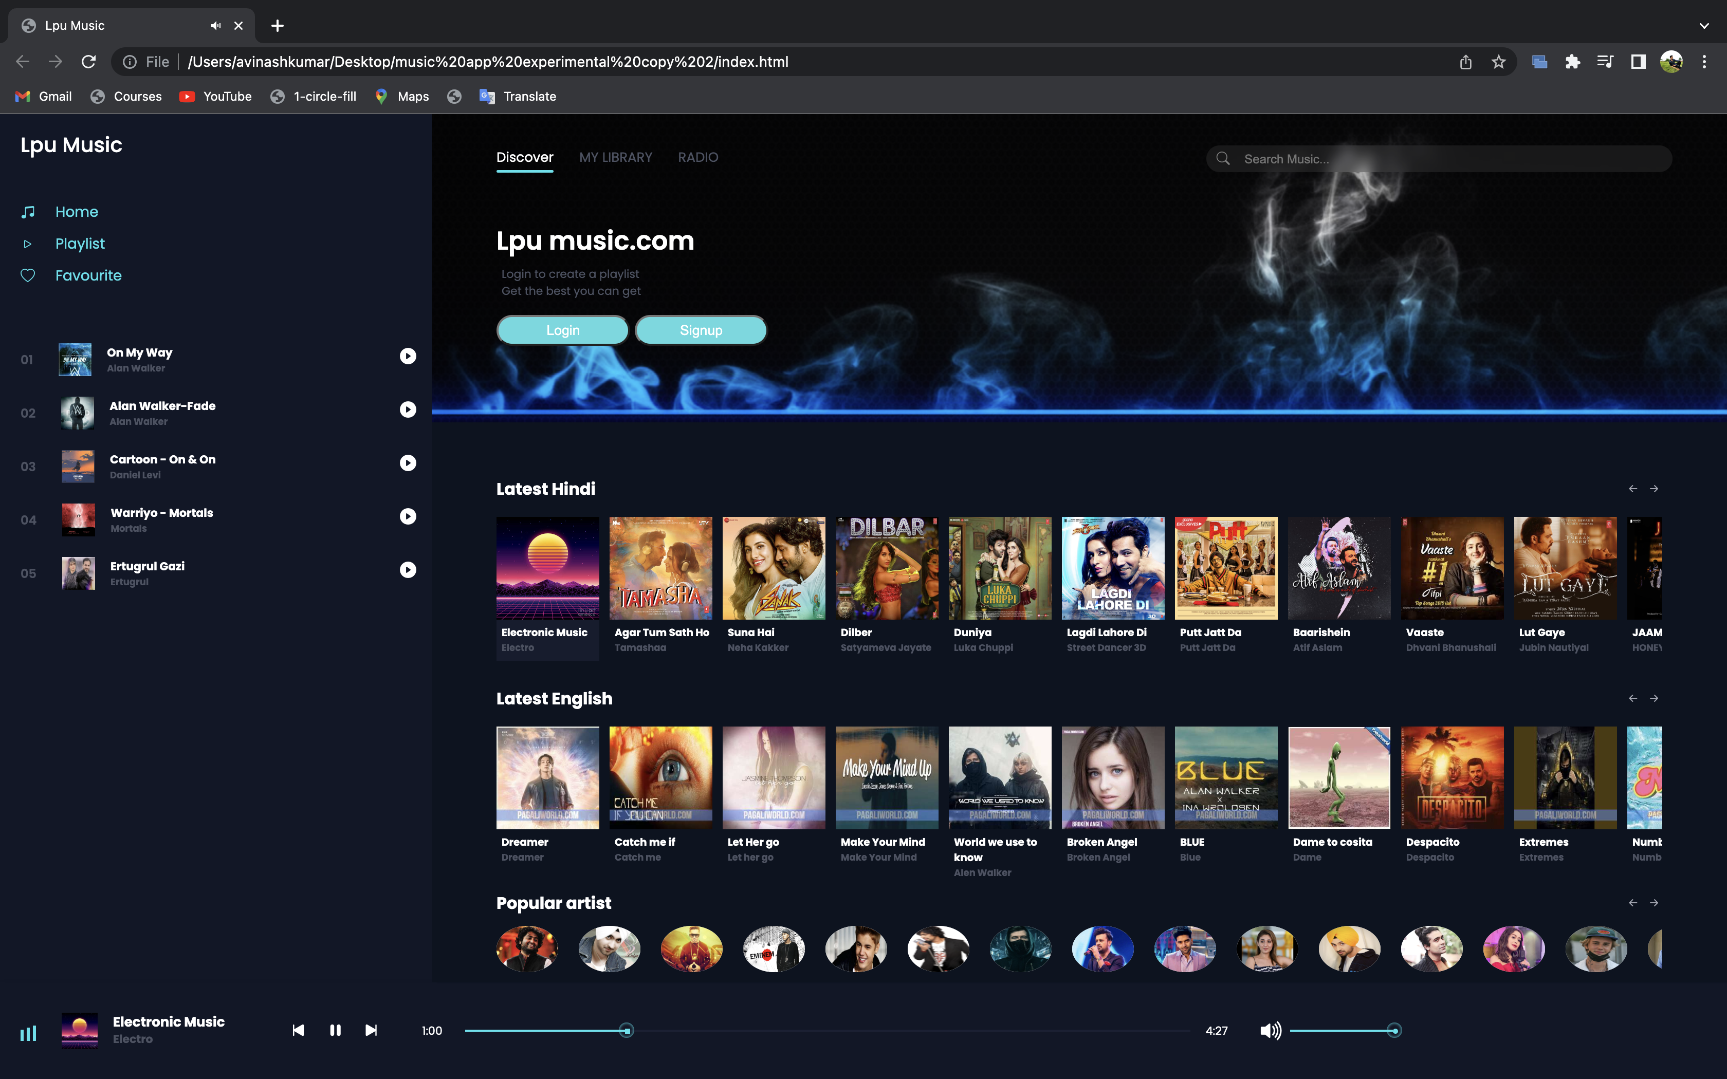
Final Website Images

Slide 22
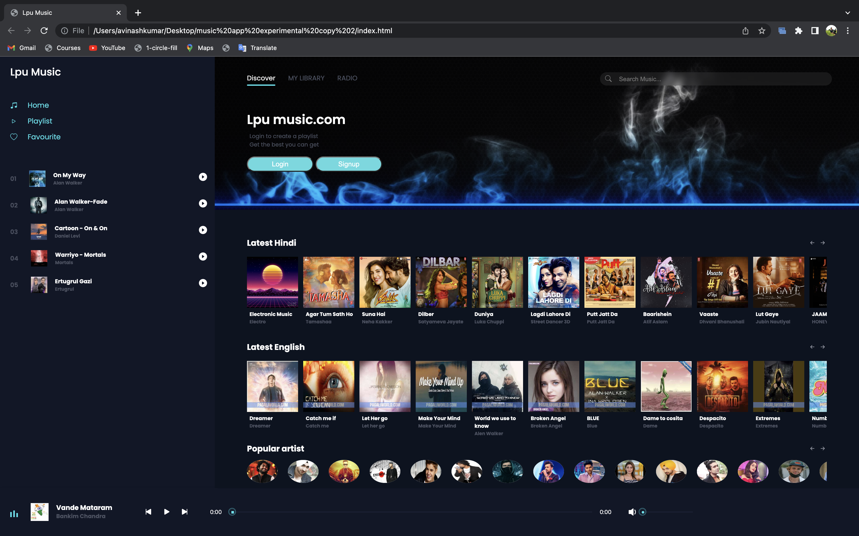
LpuMusic

Slide 23
HARDWARE
HARDWARE
Processor | : | Pentium 2.4 GHz or above
Memory | : | 256 MB RAM or above
Cache Memory | : | 128 KB or above
Hard Disk | : | 3 GB or above [at least 3MB free space required]
PenDrive | : | 5GB
SOFTWARE
Operating System | : | Windows 10
Font-End Tool | : | JavaScript, Html,Css, bootstraps
Backend | : | SQLite, Django, Python
BROWSER : Google Chrome, Microsoft edge, Safari e.t.c………..

Slide 24
Refrence
W3school:-https://www.w3schools.com/
Youtube:- https://www.youtube.com/
Geeksforgeeks:-https://www.geeksforgeeks.org/
Code with harry:-https://www.codewithharry.com/

Slide 25
Bibiliography
Online refrence:-
• W3School (FOR REFERCE TO CODE)
• GITHUB (FOR TAKING EXAMPLE)
HELPING HAND
• Sheetal Chahaun(TEACHER)
TEAM MEMBERS
• Ashwani Singh(02)
• Vikash(09)
• Adarsh Kumar(29)

